Slide 1




PROJECT PORTFOLIO
Streamlining Your Schedule
Submission of phase 02 (Development Phase)
Student: Husain M. Alghasrah
Matriculation Number: 92107683
Tutor: Sandra Rebholz
Phase 2: Development Phase/Reflection Phase
https://github.com/halghasra/PlanMate

Slide 2
Introduction
In our fast-paced world, staying on top of personal, work, and family tasks can be tough. Juggling multiple calendars often leads to confusion and stress.
Enter PlanMate, your go-to solution for easy scheduling. This app brings all your tasks and appointments together, giving you a clear view of your day. Create, view, and manage events effortlessly.
Sort tasks into categories and choose your preferred view—day, week, month, or year. PlanMate smoothly handles overlaps and conflicts, keeping your schedule seamless.
Enjoy increased productivity and clarity with PlanMate. Stay organised and access your schedule anytime, anywhere.
Experience hassle-free scheduling with PlanMate.
Features:
One calendar for all tasks and appointments
Categorize tasks for better organization
Choose your view: day, week, month, or year
Smooth handling of overlaps and conflicts

Slide 3
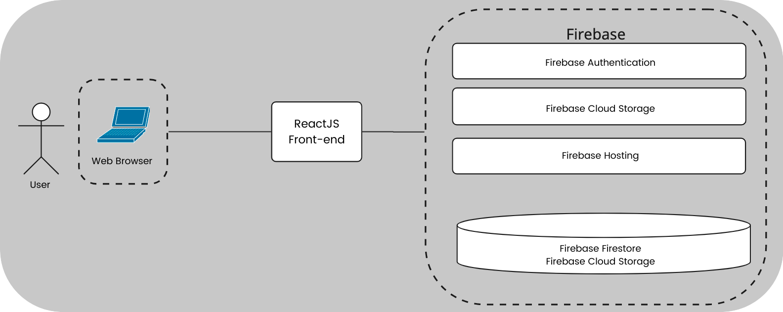
Architecture Diagram
PlanMate employes a well-structured architecture to ensure efficient functionality and user interaction.
The user interacts with the application through a standard web browser.
ReactJS Front End: The front-end interface, built using ReactJS, offers a responsive and intuitive user experience.
Firebase Backend: PlanMate’s backend, hosted on Firebase, integrates key services for a seamless operation.
Firebase Authentication: Ensures secure user authentication and access control.
Firebase Firestore: Provides a versatile and scalable NoSQL database for storing calendar and user data.
Firebase Cloud Storage: Offers reliable cloud storage for user-related assets.
Firebase Hosting: Facilitates the delivery of the front-end, ensuring optimal performance.

Slide 4
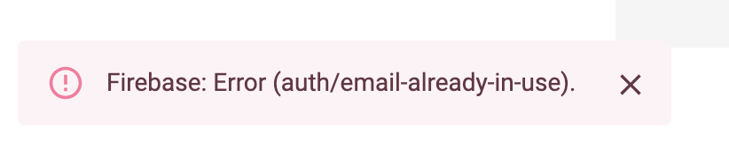
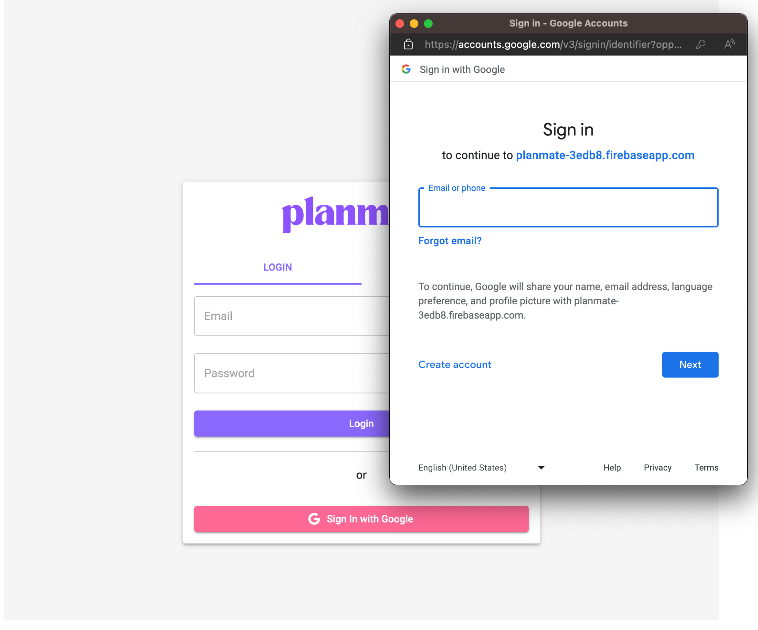
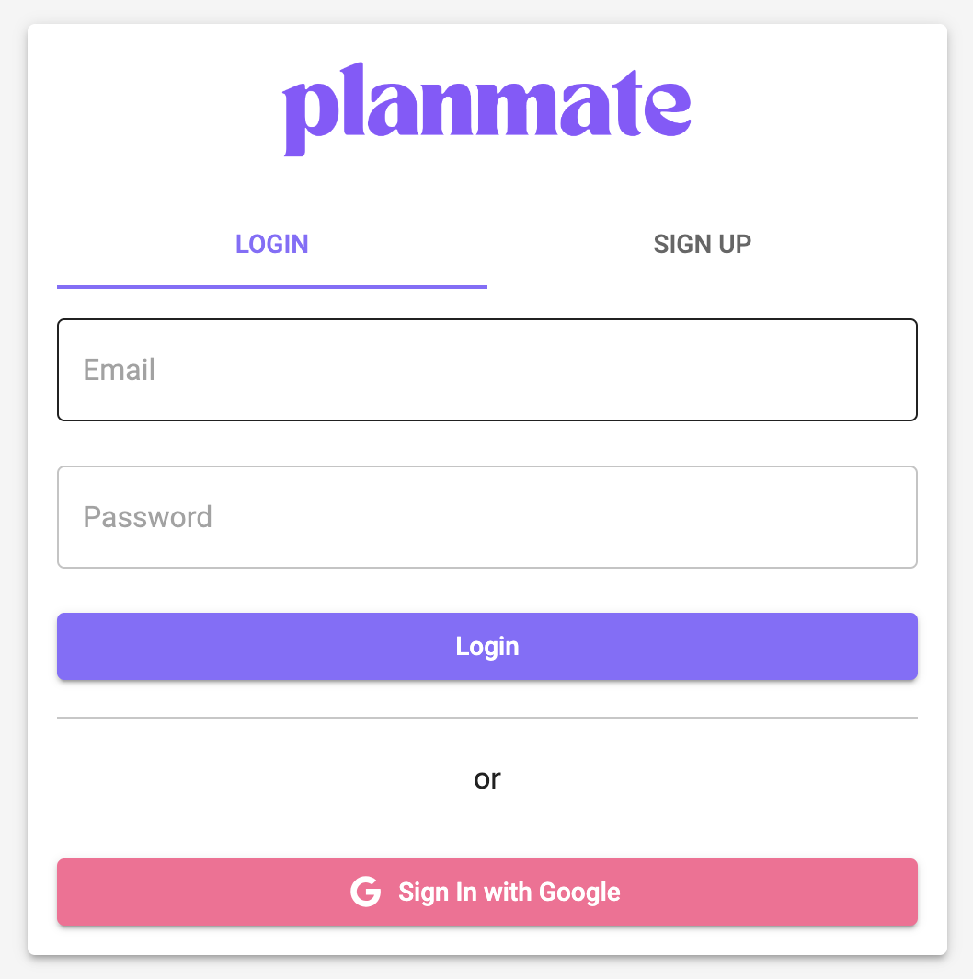
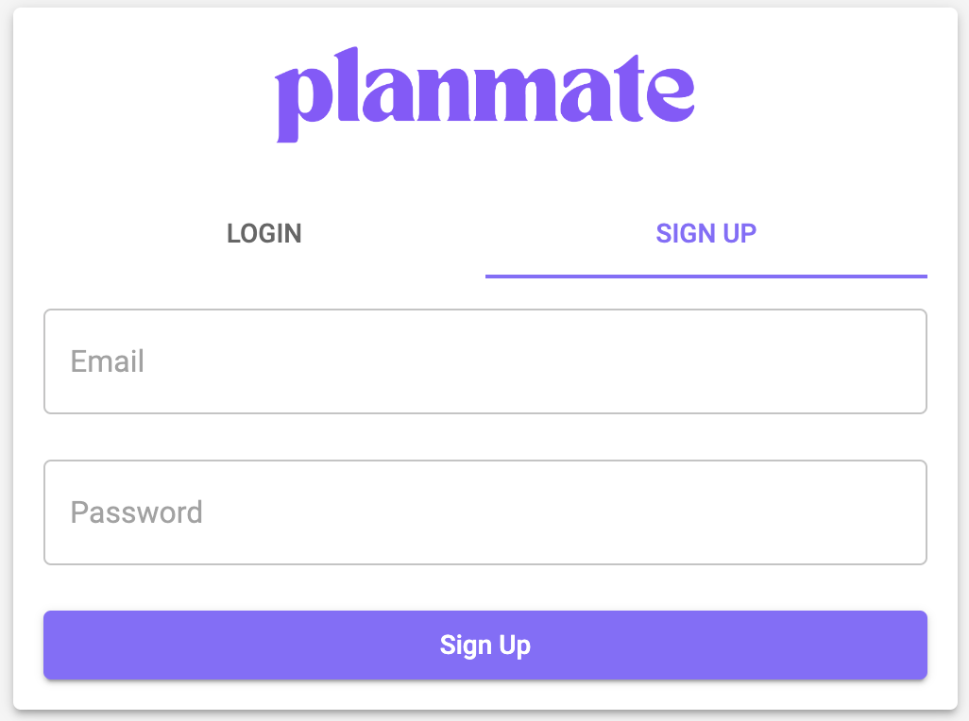
Login Page
This page allows the user to login to the app using their credentials, or sign in/sign up with their Google account. It also allows the users to sign up to use the app. It uses Firebase Authentication to authenticate the users and provide secure login to the web application.
Error messages:
Sign up Tab
Sign up with Google
Login Tab

Slide 5
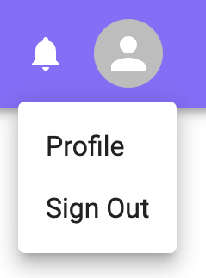
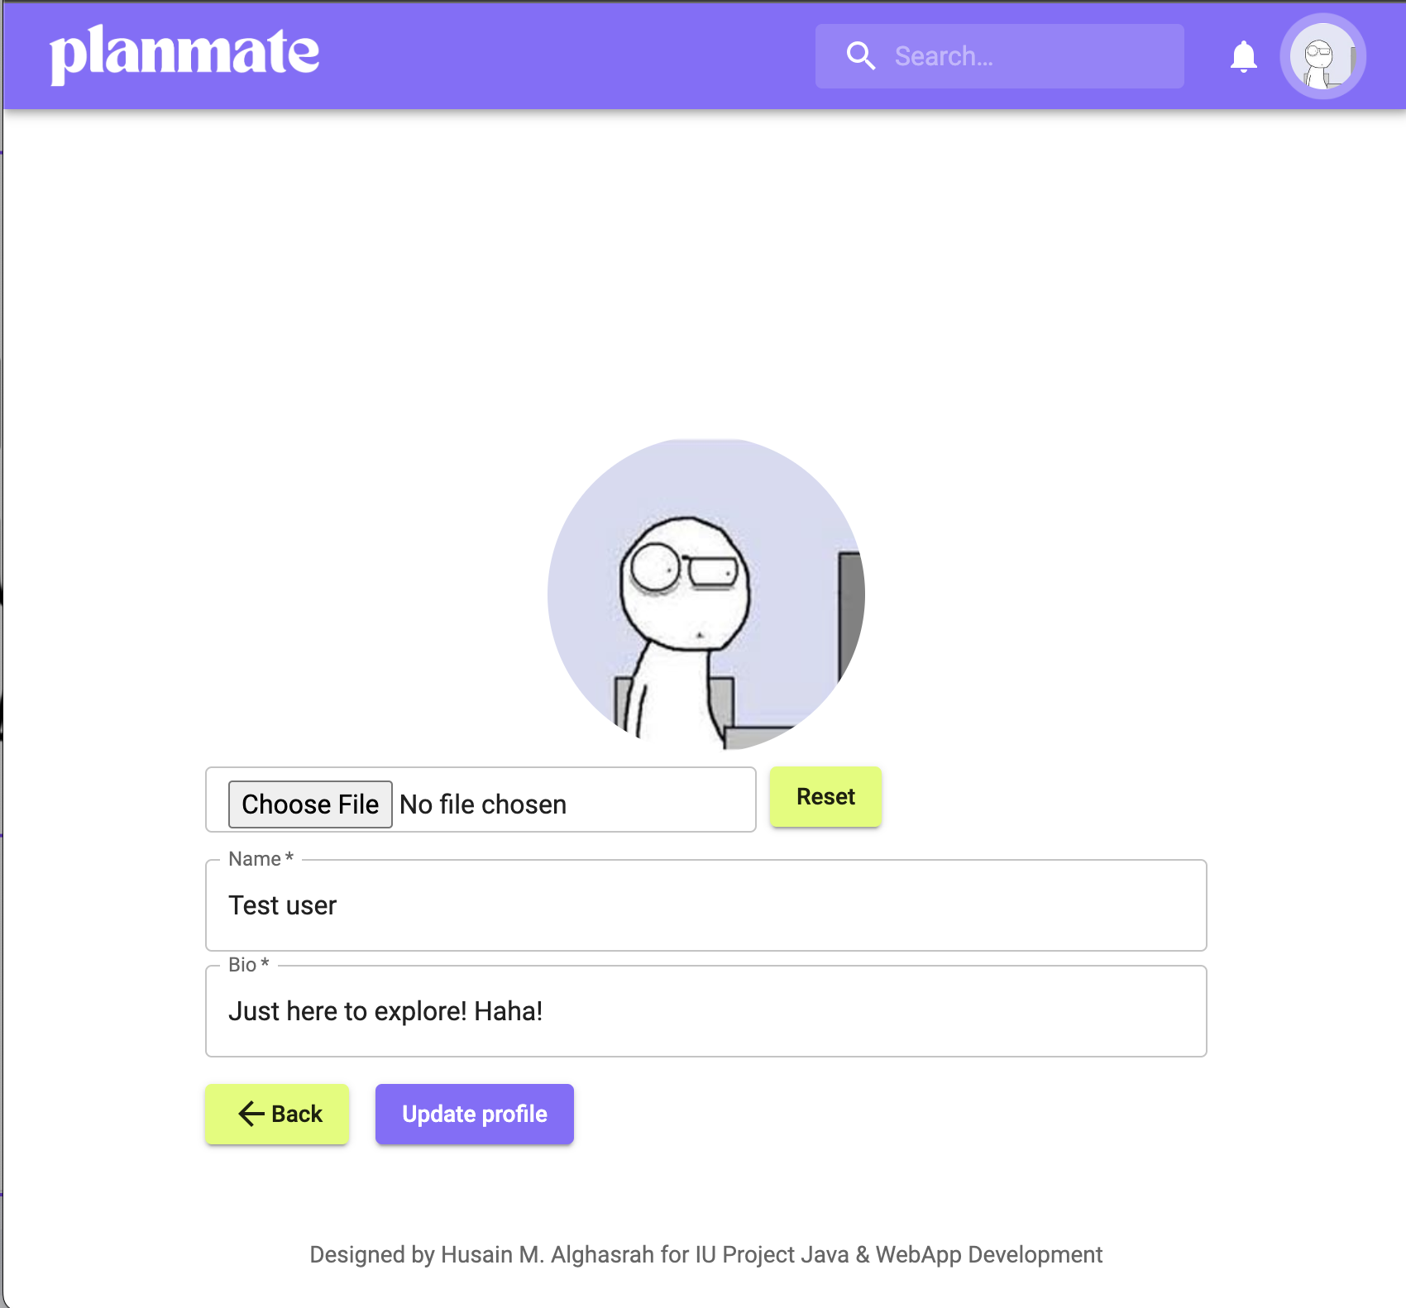
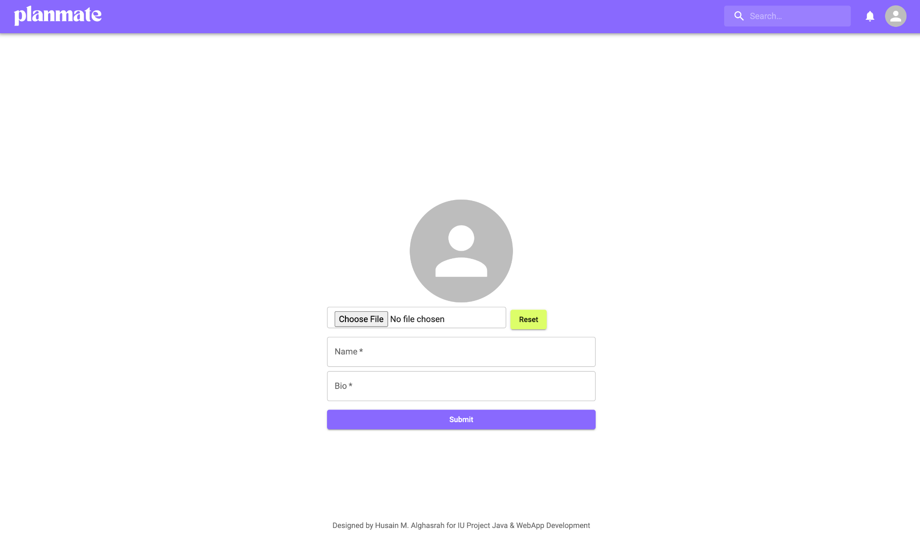
Profile Pages
Profile Completion Page
Profile Page
Once the users are logged in, they can access their profile via the menu by clicking on the user profile avatar:
This page appears to signed up users asking them to complete their profiles. The users can upload a profile image (securely stored in Firebase Cloud Storage), Add their names and bio information. This page only appear once during the signing up process.
Users are able to update their profiles via this page:

Slide 6
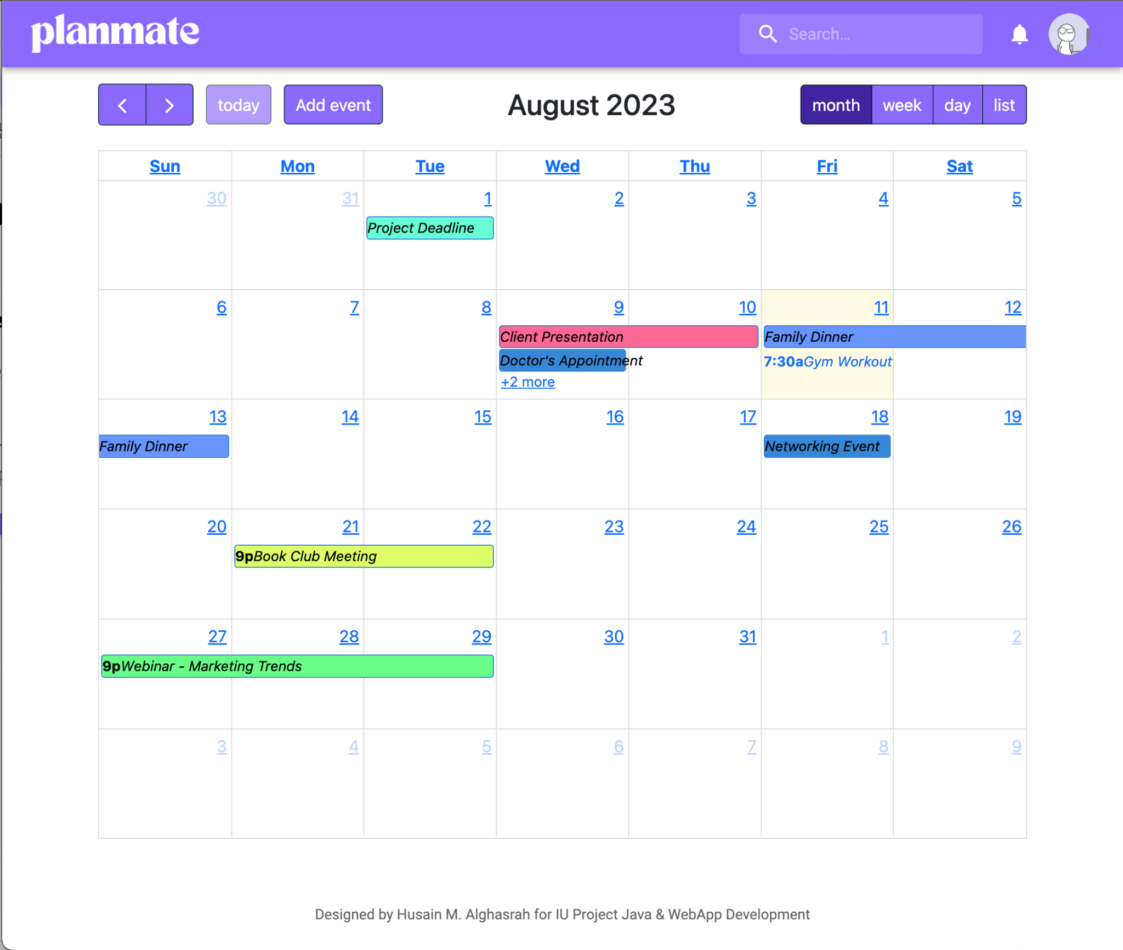
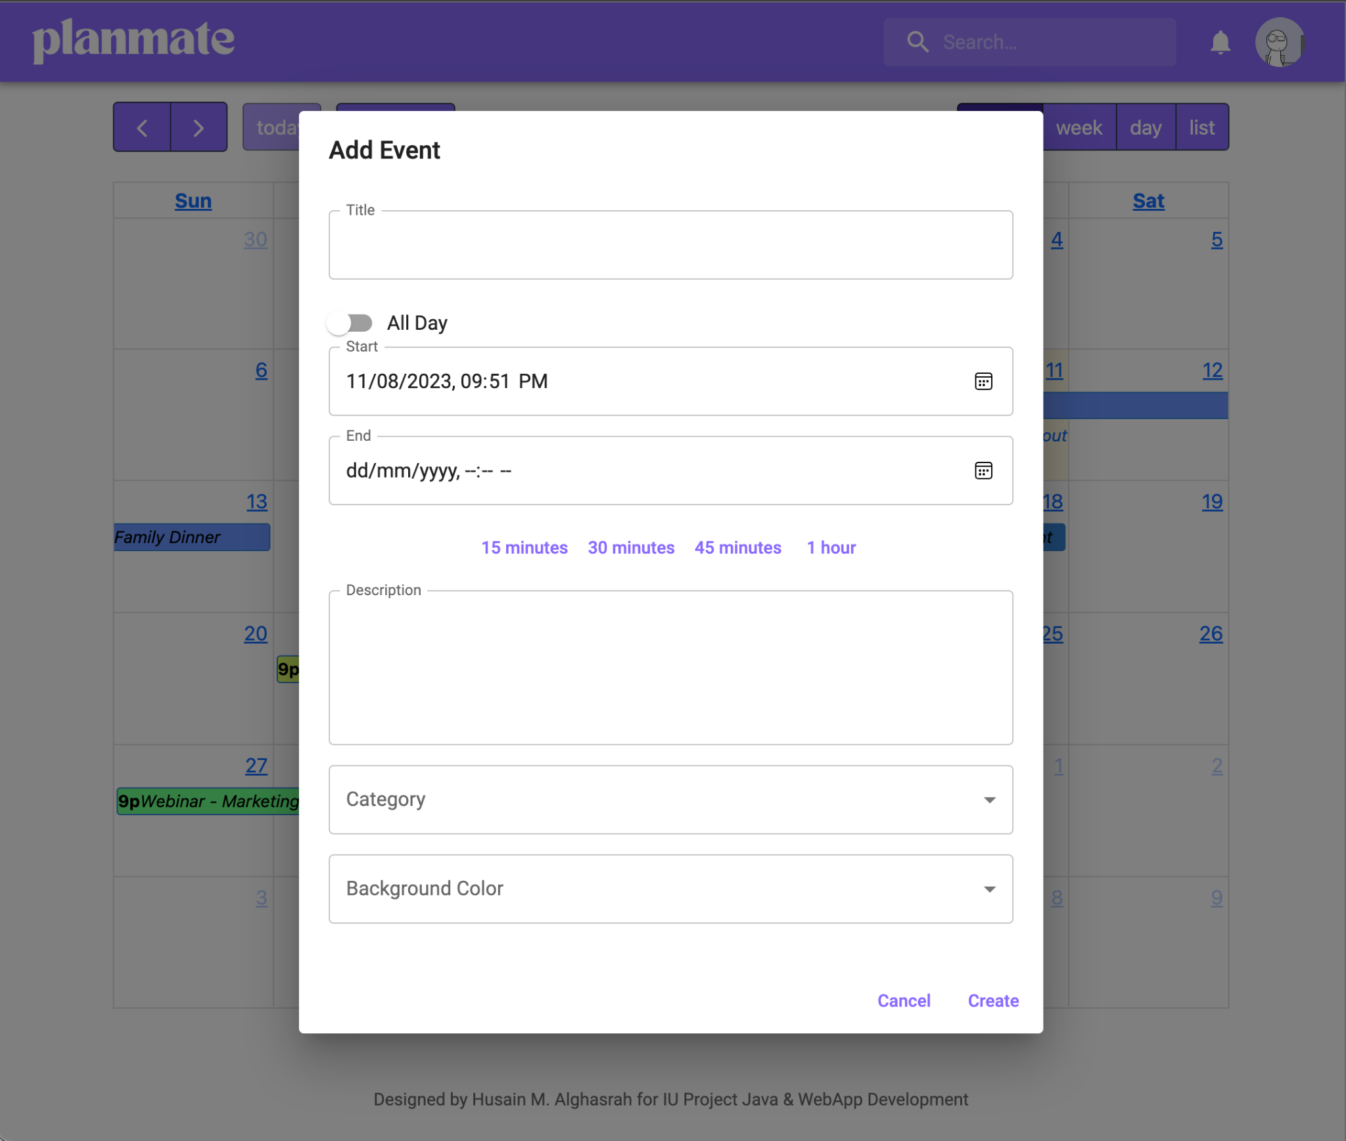
Home Page: Calendar
The home page includes the calendar where the users could have a quick look on their schedules. The users could switch between month, week, or day views to access more information about their tasks and events. Users can also drag and drop events, expand and reduce them, or simply delete them, without the need to access further screens.
Add events popup
Main calendar view

Slide 7
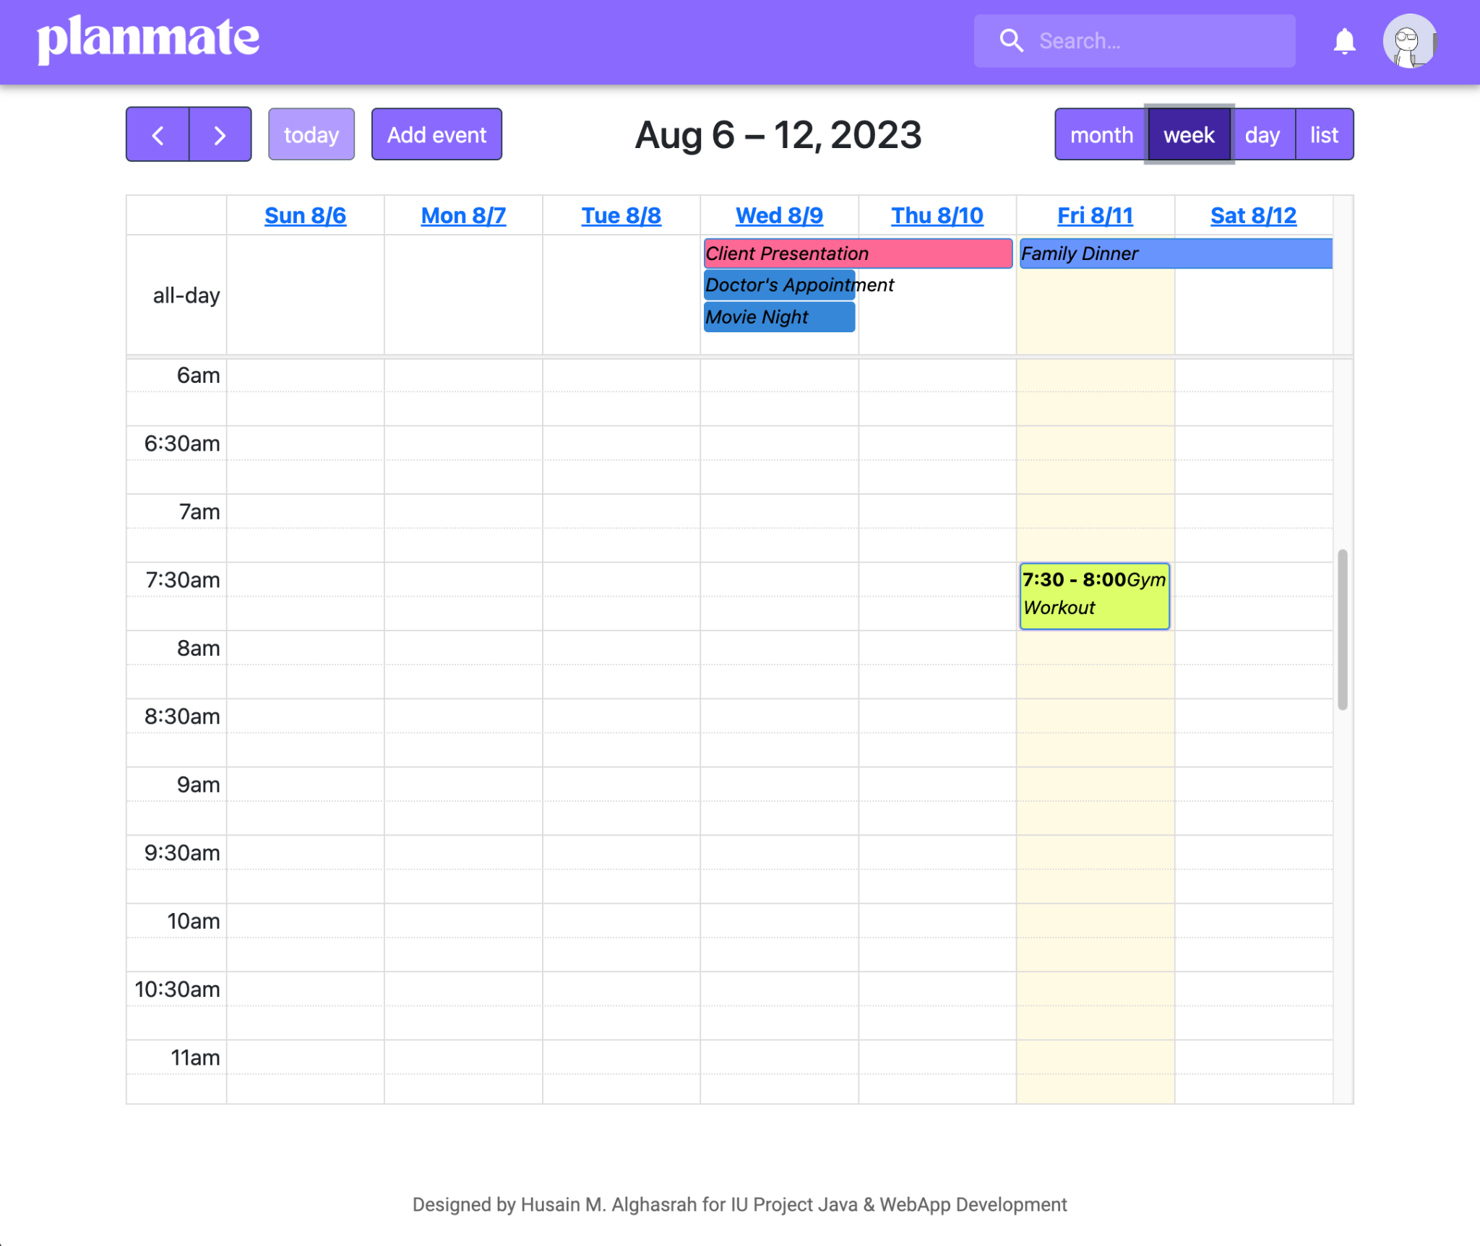
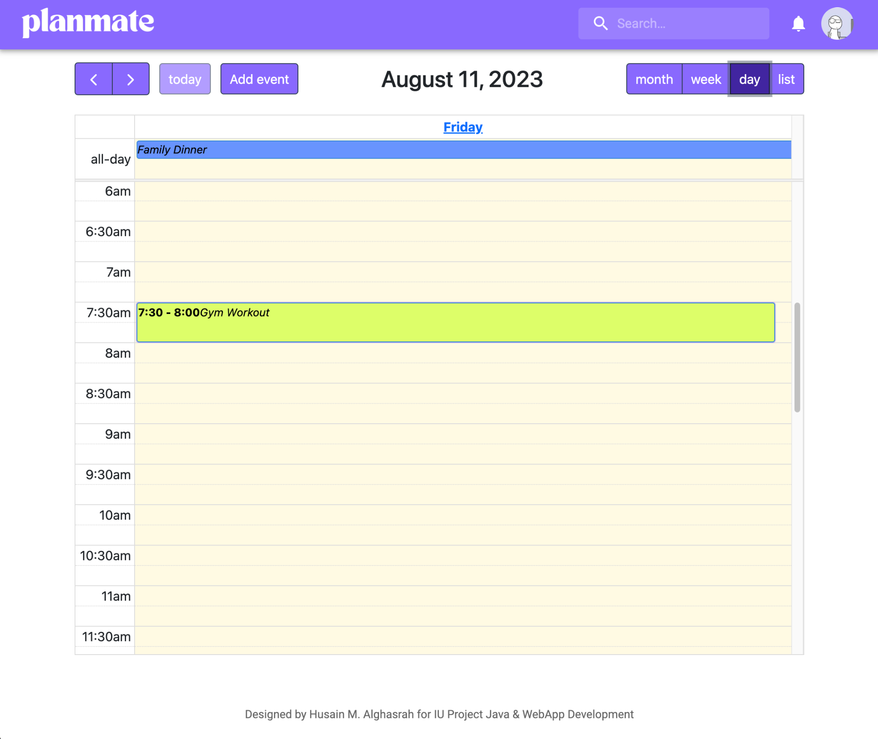
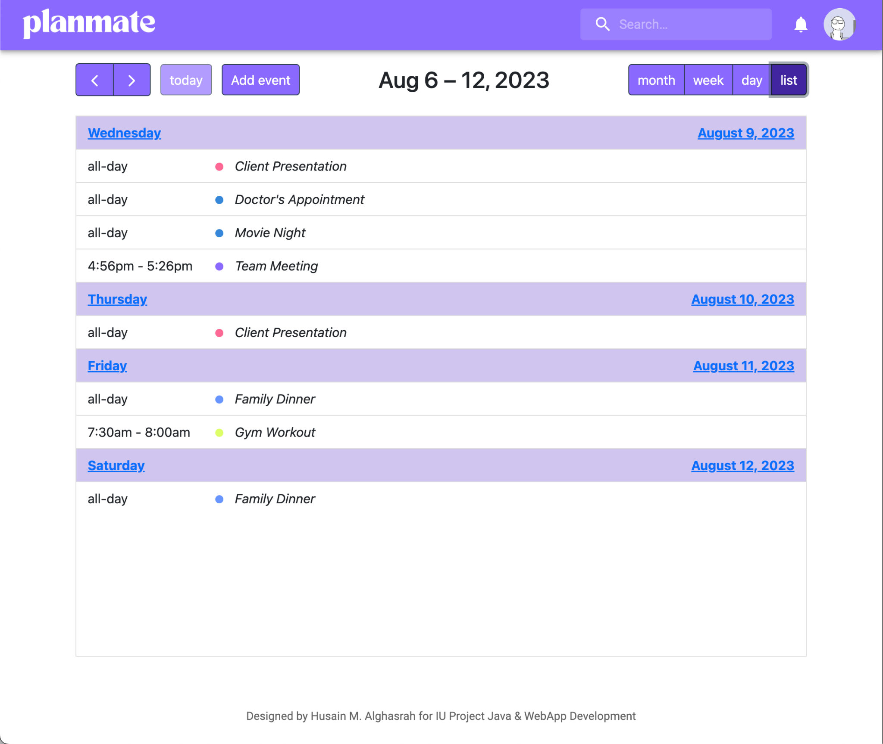
Home Page: Calendar views
Week view
Day view
Events list view

Slide 8
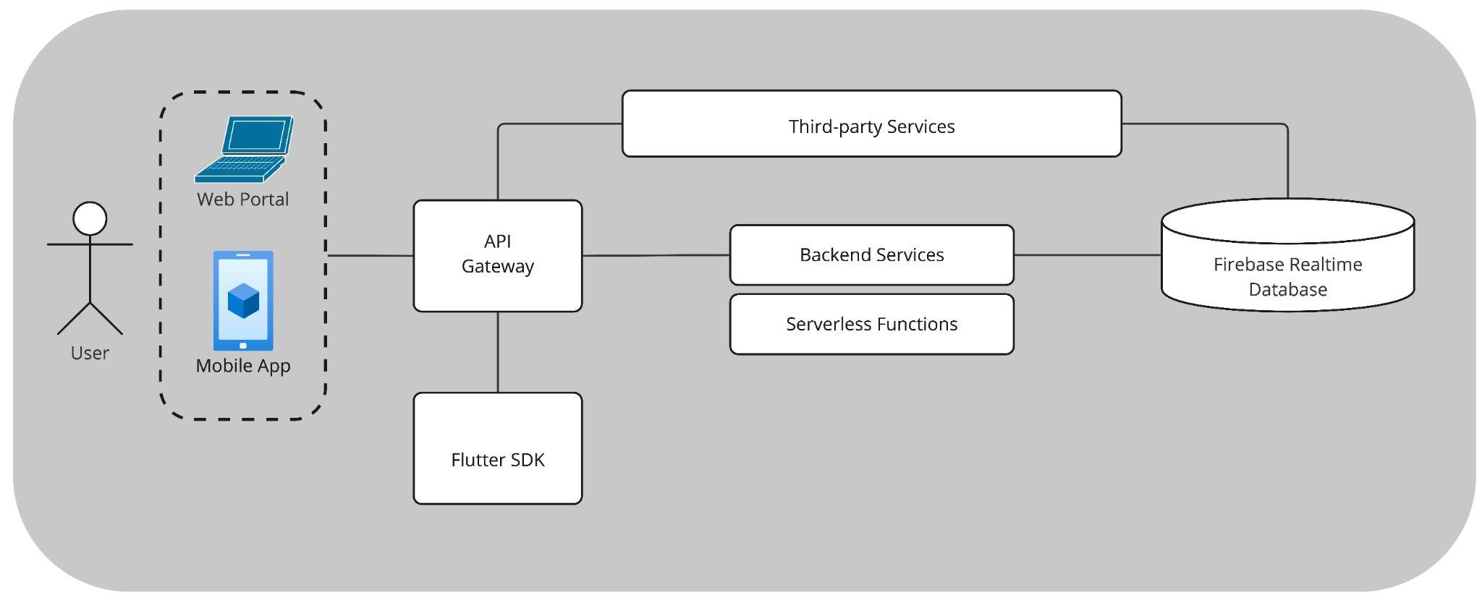
Changes from conception
I switched gears from my first idea of using Flutter and Firebase to building the app with React while sticking with Firebase for the backend.
Why?
React gives me more flexibility and I found that it’s backed by a strong community, unlike Flutter which is still new and community support is limited. This change helped me work faster, use resources wisely, and make sure the app would provide users with a smooth experience.

Slide 9
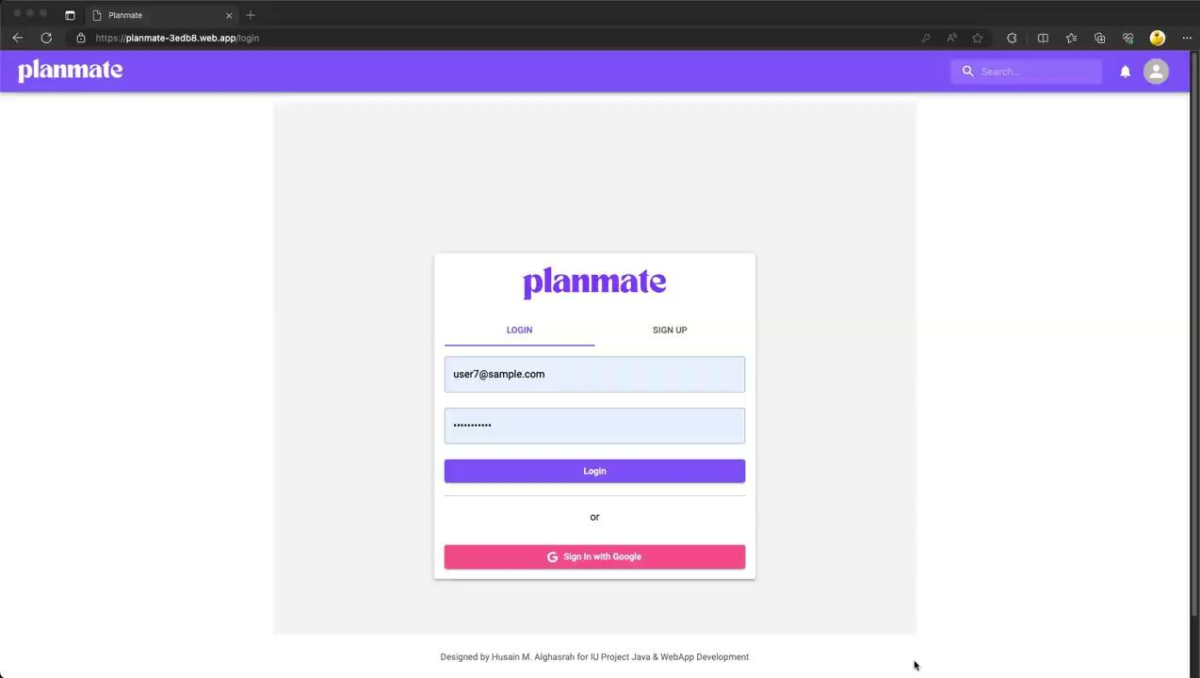
Application Walkthrough
Note: In case the video is not working, please access it from Google Drive via this link.

Slide 10
Thank you
Husain Alghasrah

